Slide 1

Swan_soundbar_DVT_MIC_sesaling test
ALT Co., Ltd.
Issued Date
Issued by
2021.03.23
SH, SON
Ver.1.0

Slide 2
Test info for simple test
  Date : 2021.03.22 14:00~
  SW version : V19.522.49
  Location : Inkel Anechoic room
  Test stream : Youtube 20-20,000hz Audio Sweep
    https://www.youtube.com/watch?v=PAsMlDptjx8&ab_channel=SonicElectronix
Test conditions
  Audio source : Youtube play using Bluetooth
  Audio play : SoundBAR (Bose Solo TV speaker)
    Audio Source / Play : max volume
  Recording SWAN MIC and playback
Test Flow
  Play audio source (Sweep) -> recording SWAN, opened mic hole
  Play audio source (Sweep) -> recording SWAN, closed mic hole
  Compare raw recording file using adobe Audition
Test command
  adb shell
  $ su
  # setenforce 0
  # dmesg -n 1
  # echo "0 0 0 0" > /proc/sys/kernel/printk
  # service call bluetooth_manager 8
  # tinycap /sdcard/test.wav -D 0 -d 0 -c 4 -r 48000 -b 32 -p 384 -n 32 -T 120

Slide 3
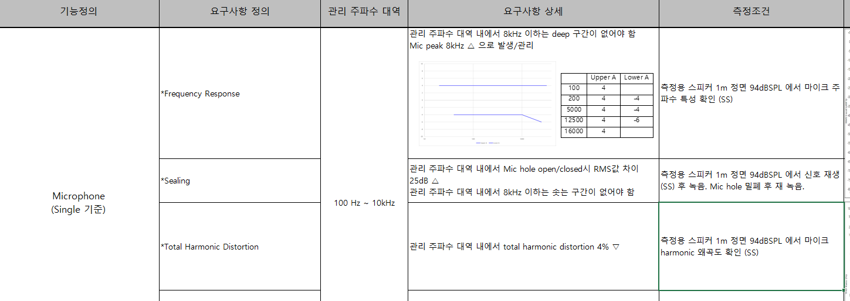
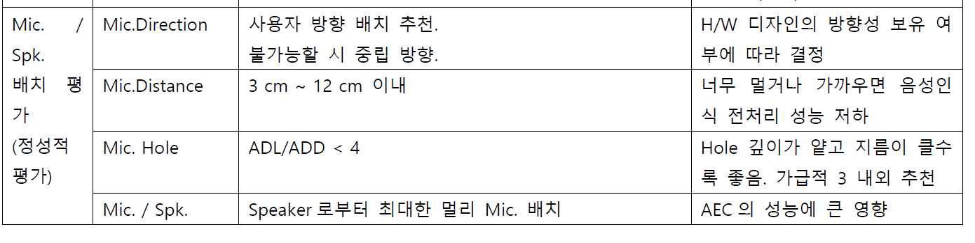
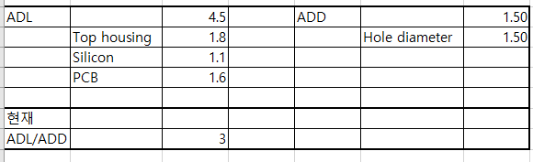
MIC sealing spec by RFP
ADL/ADD spec by RFP DVT design

Slide 4
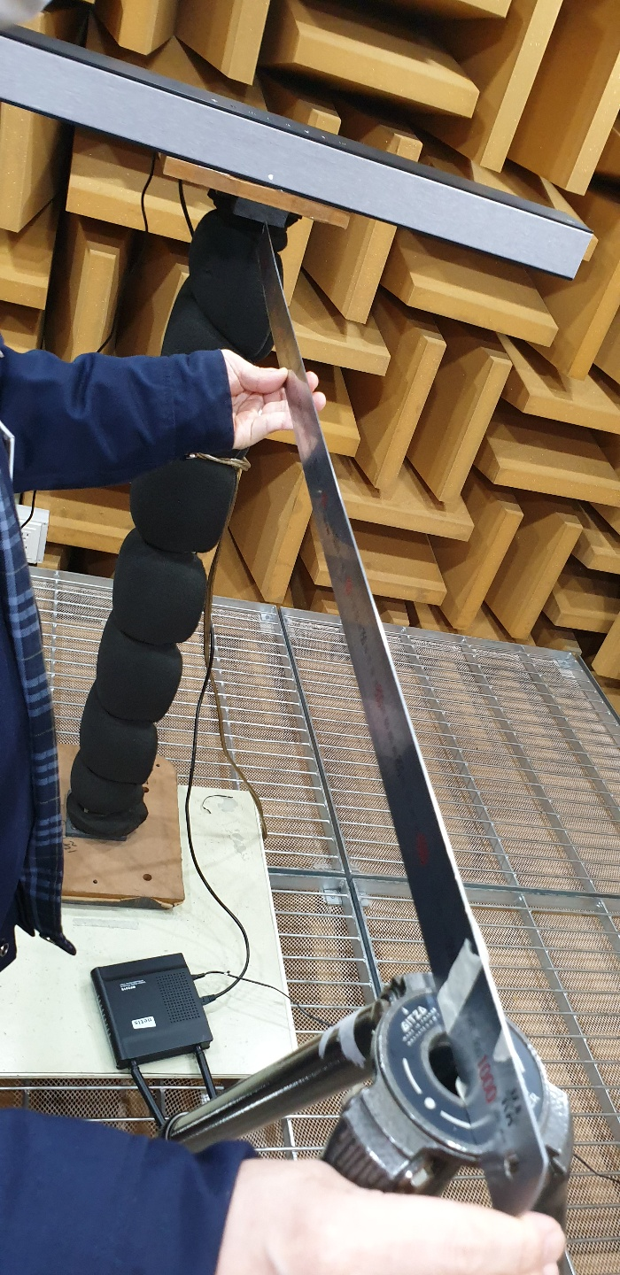
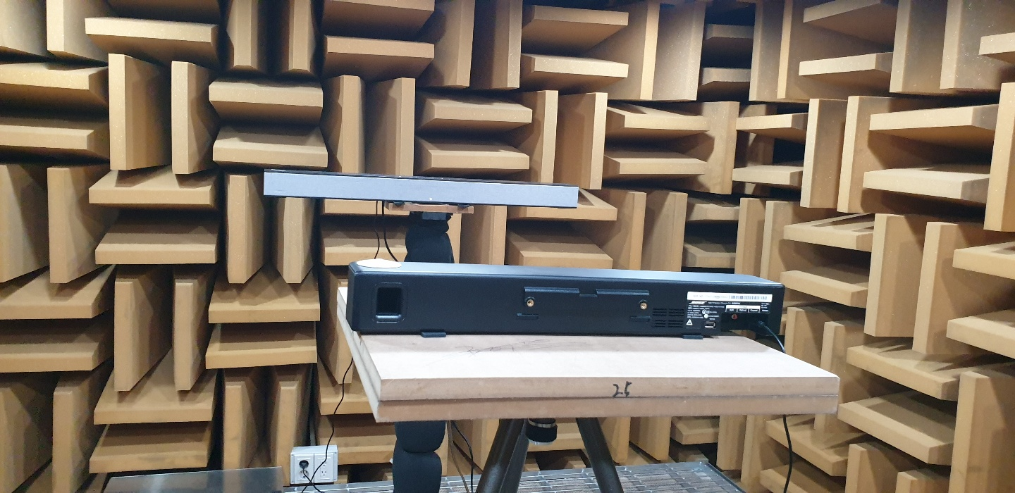
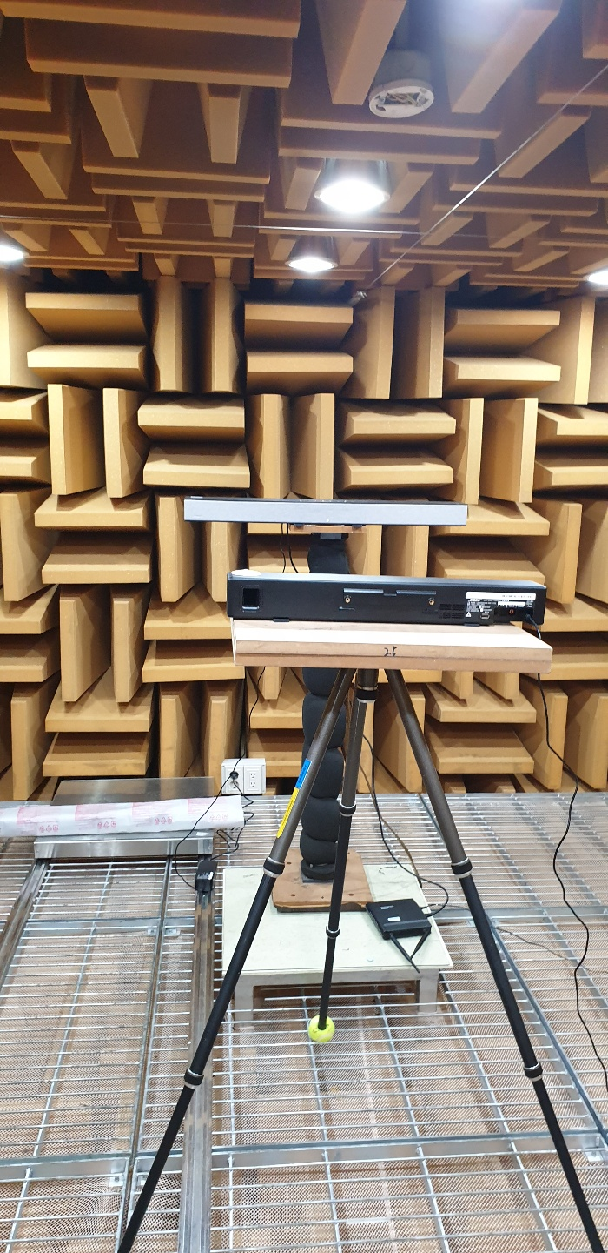
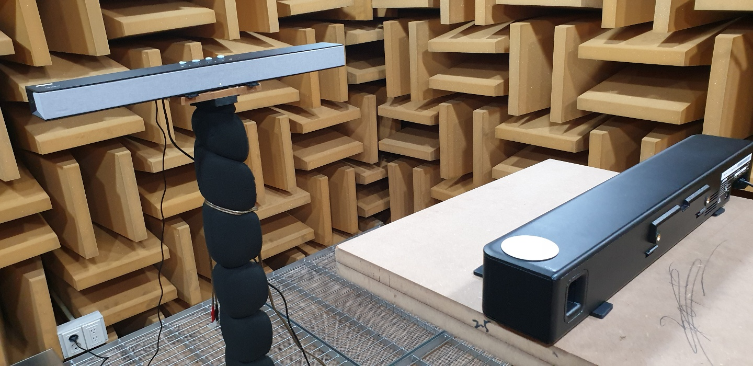
Test picture

Slide 5
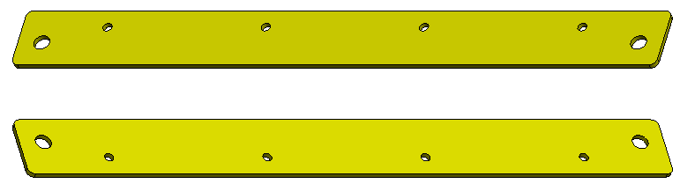
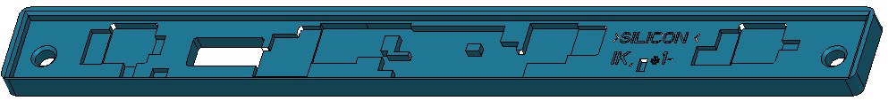
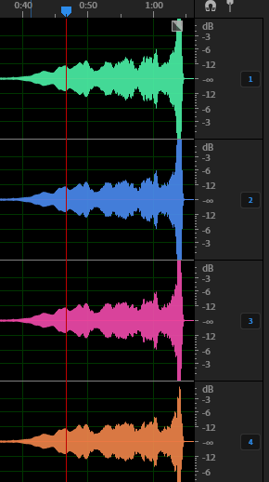
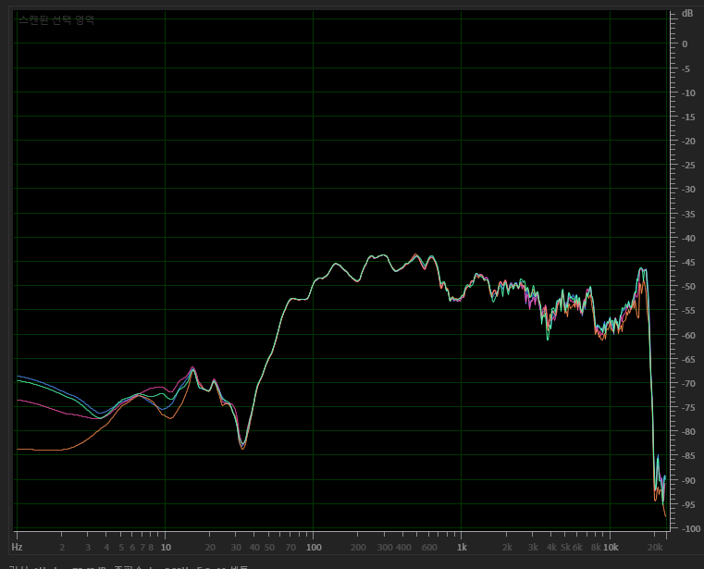
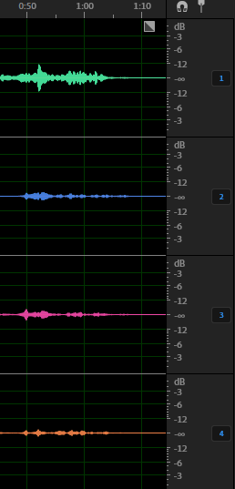
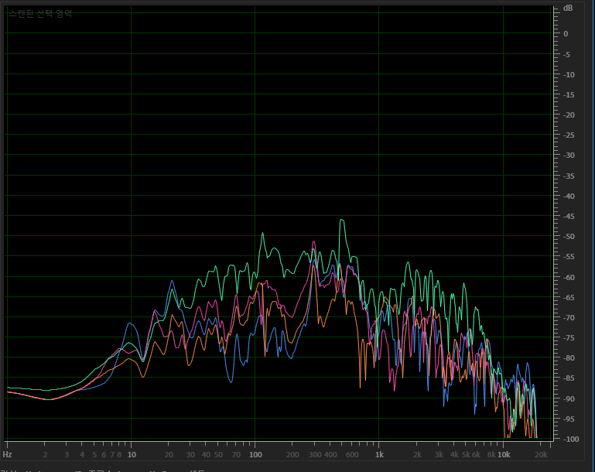
SPONGE_MIC_SILICON 1.1t
DVT rubber
MIC hole open
MIC hole closed

Slide 6

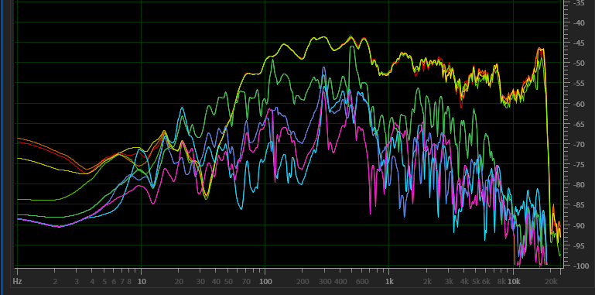
Test result marge
CH1~4 : MIC hole open
CH5~8 : MIC hole closed

Slide 7
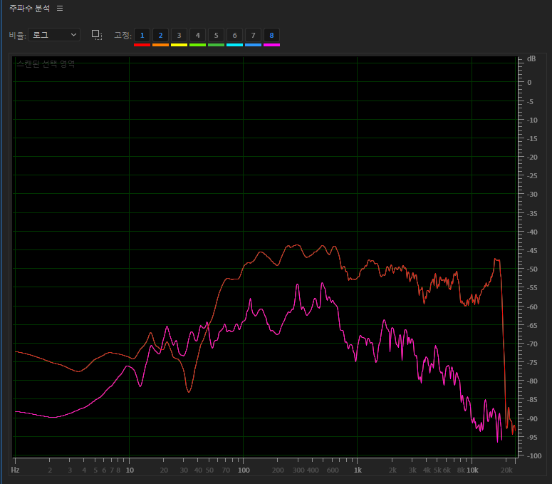
Weak point : 300 / 500hz
MIC hole open
MIC hole closed

Slide 8
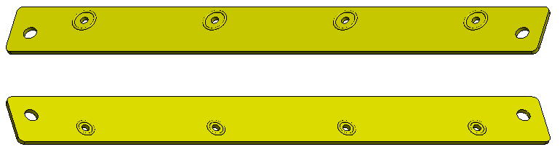

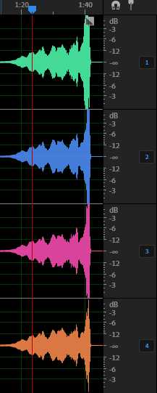
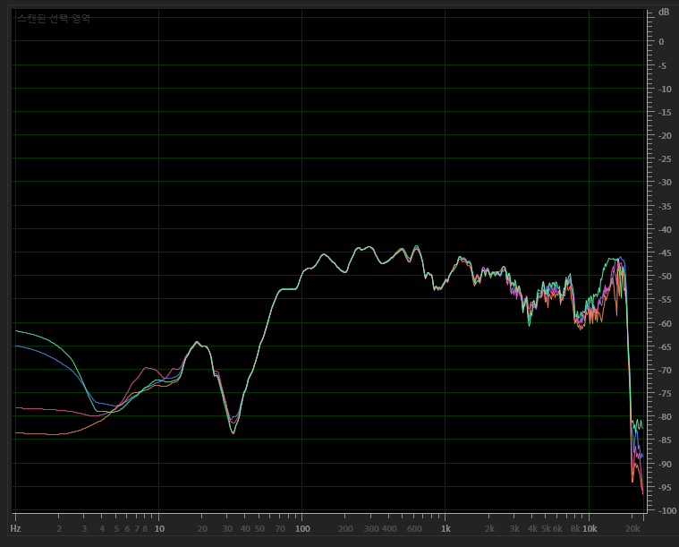
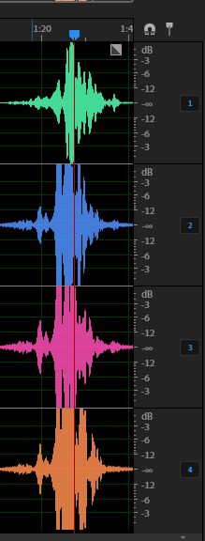
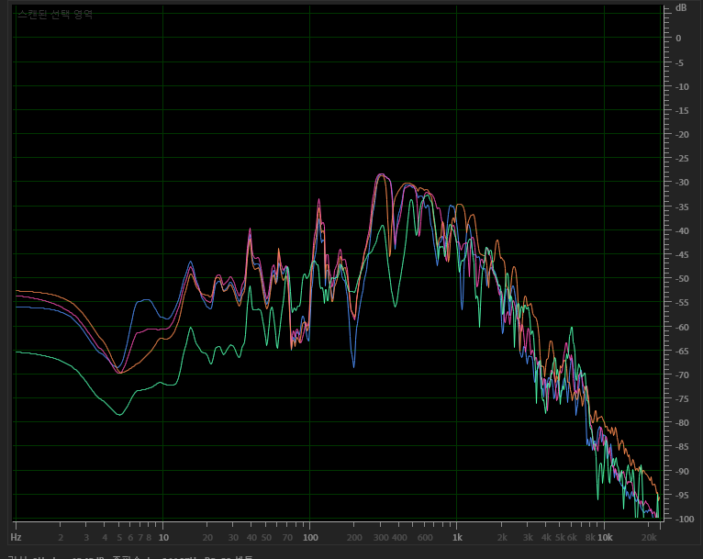
SPONGE_MIC_SILICON 0.5t
DVT new rubber
MIC hole open
MIC hole closed

Slide 9

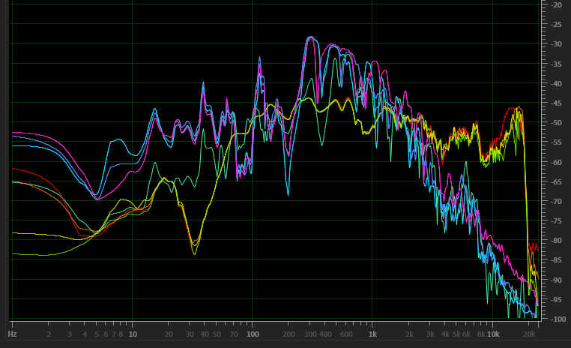
Test result marge
CH1~4 : MIC hole open
CH5~8 : MIC hole closed

Slide 10
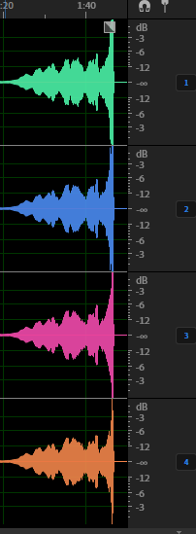
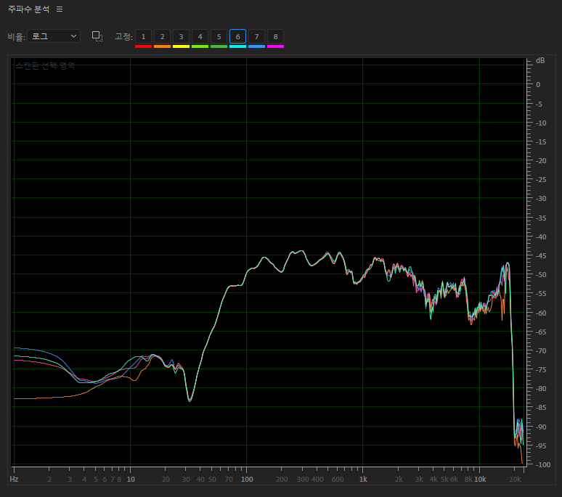
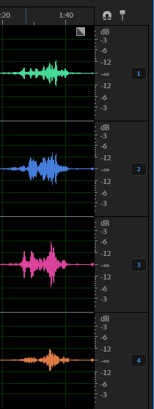
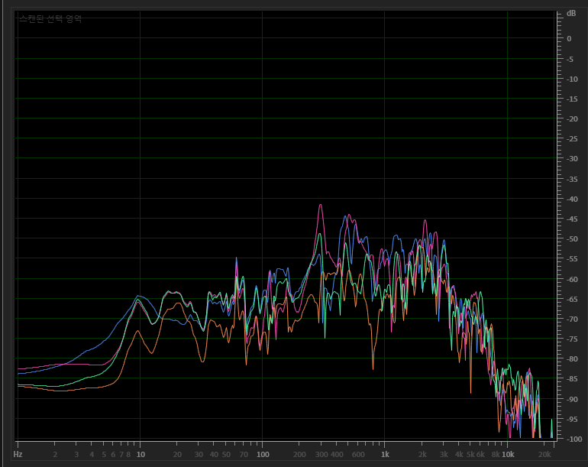
DVT new rubber + add 0.5t thickness
SPONGE_MIC_SILICON 0.5t
MIC hole open
MIC hole closed

Slide 11
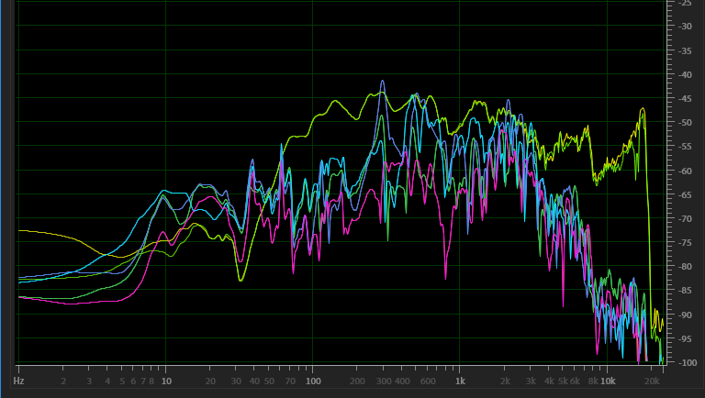
Test result marge
CH1~4 : MIC hole open
CH5~8 : MIC hole closed

Slide 12
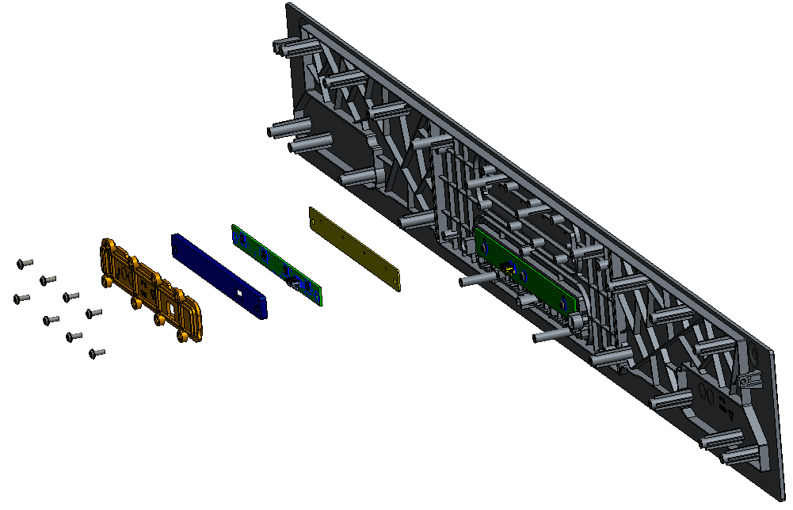

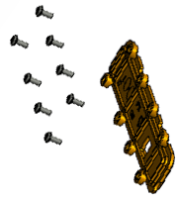
DVT new rubber + add 0.5t thickness
MIC board assembly
Top Cover
MIC Board
Holder MIC
Silicon MIC
Sponge MIC Silicon (new)
Screw M3_7mm x8
to add 0.5t thickness

Slide 13
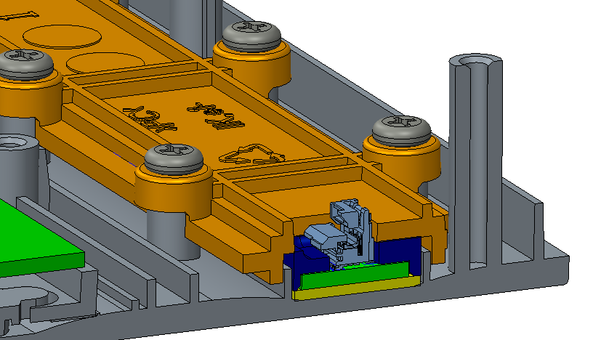
Test result
  All of mic sealing test conditions are fail
  Of the three test conditions, the DVT result is the best.
Analysis
  DVT housing, the Holder MIC is designed based on the thickness of SPONGE_MIC_SILICON 1.1t
  In case of SPONGE_MIC_SILICON 0.5t (as FII suggestion), insufficient pressure on the MIC hole.
  : Resonance occurred between the PCB and housing
  As a result not sealing of Mic (page 8)
  to add 0.5t thickness between PCB and Silicon MIC
  : Resonance problem is solved (page 10).
  Weakly sealing conditions checked.
Improvement way
  uniform pressure should be applied on the PCB bottom side(Mic hole)
  We think that is better to
    apply SPONGE_MIC_SILICON 1.1t
    not apply O-ring on the PCB side.

Slide 14
Action item
  FII test result update
    DVT condition : SPONGE_MIC_SILICON 1.1t
    New silicon condition : new Silicon MIC + o-ring Sponge MIC Silicon (new)
    New condition : SPONGE_MIC_SILICON 1.1t +
  Find the solution for sealing more than -25db
Plan
  Ejection mold : Holder MIC, Top Cover -> not change
  Silicon mold
    Silicon MIC : update design as Fii suggestion
    Sponge MIC Silicon (add o-ring)
    : TBD.
    : Need to fix DVT3 conditions
    : Specification should be confirmed by next week. (3/31)
Note.
  In accordance with MIC & Speaker specifications, We must be certified using DVT3 unit by an authorized Korean testing lab.

Slide 15
End of Documents

